Slide 1
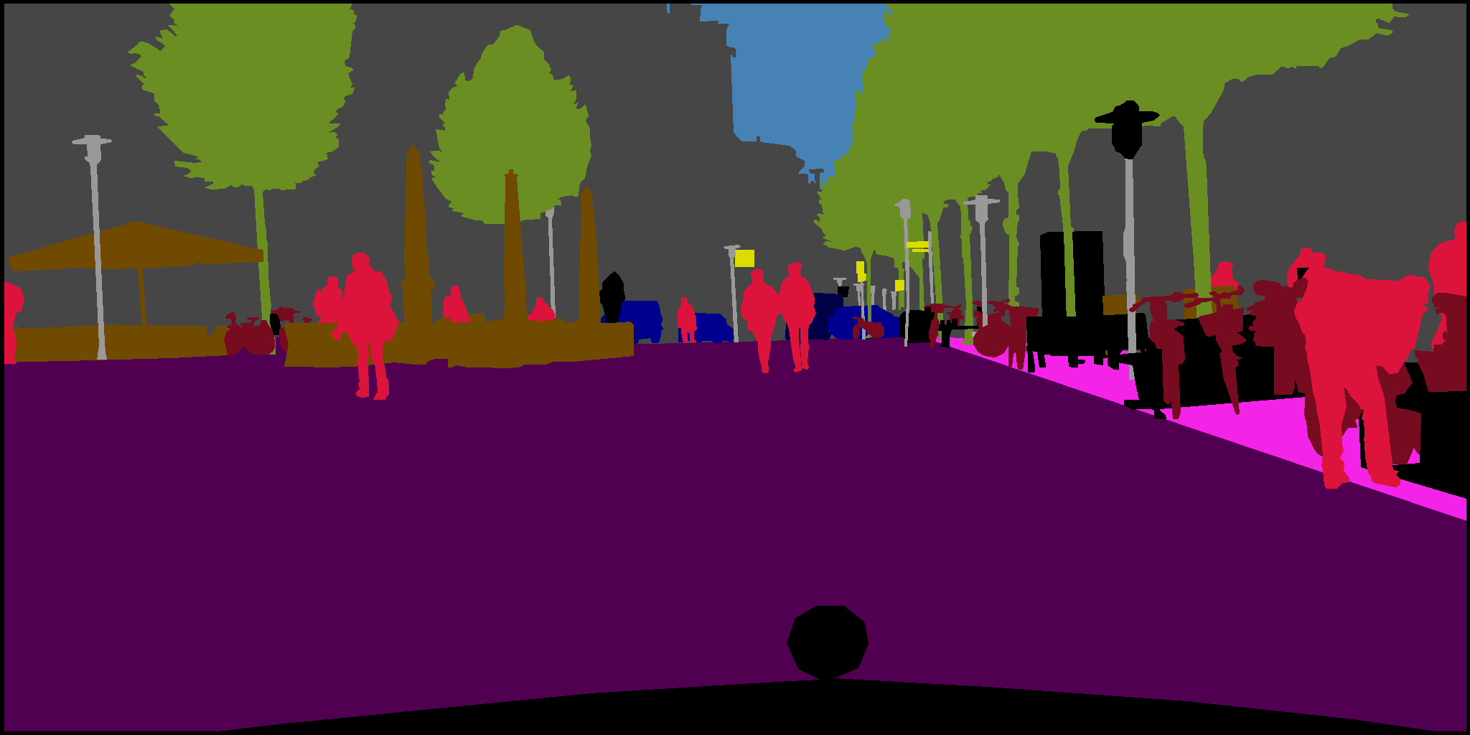
Semantic Segmentation with PixelNet on CityScapes

Slide 2

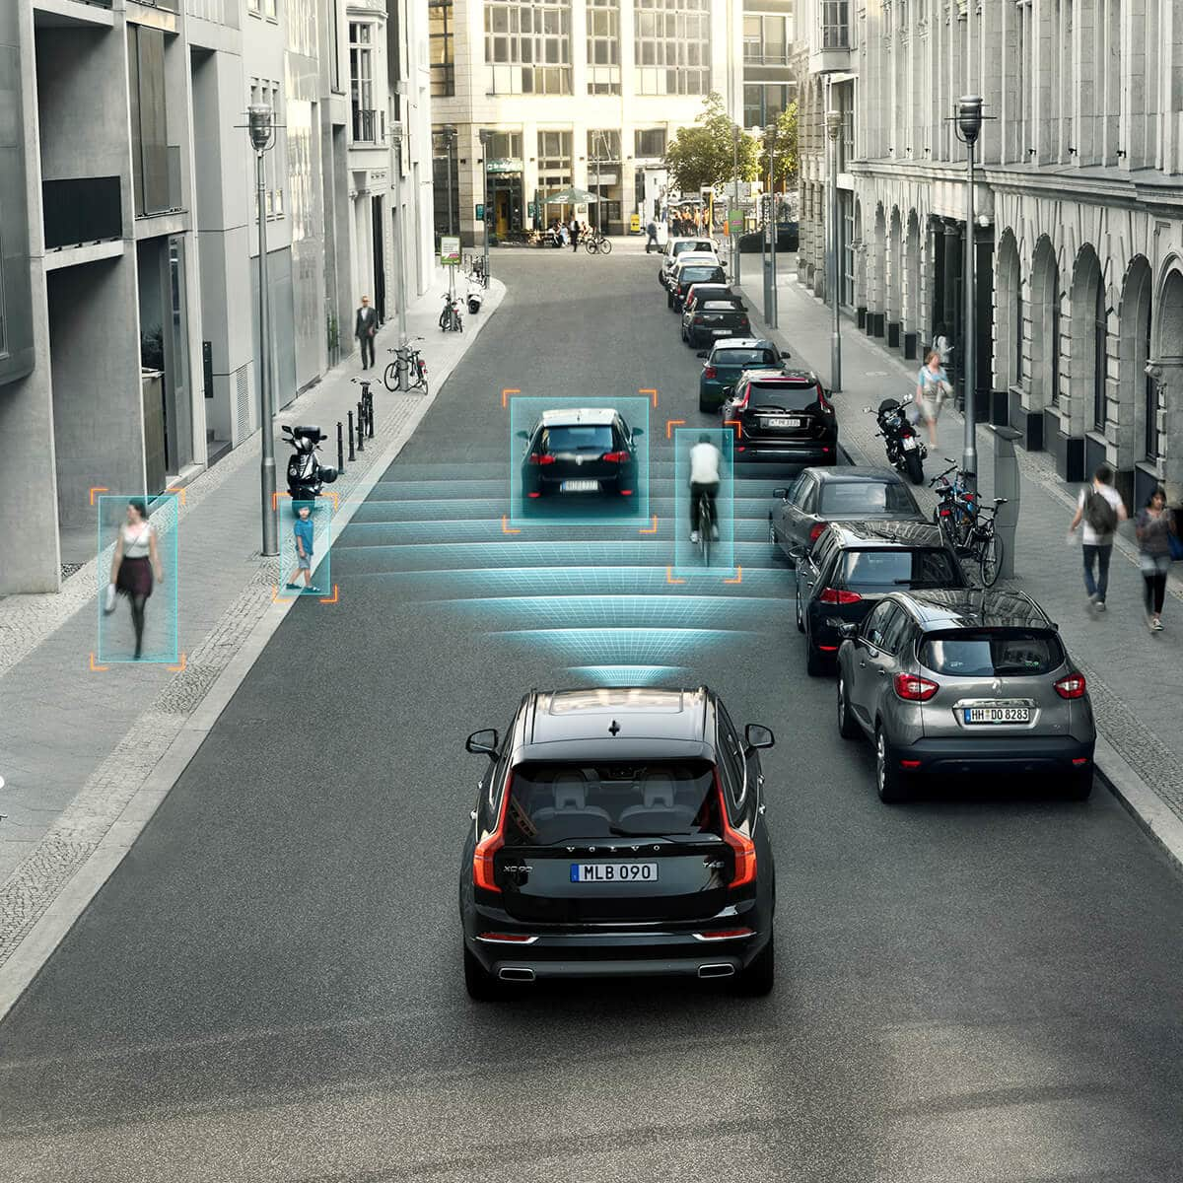
The Importance of Semantic Segmentation
Semantic Segmentation
attempts to partition the image into semantically meaningful parts in order to classify each part
Notes:
Important task for different areas of applications
Robotics
Autonomous driving

Slide 3
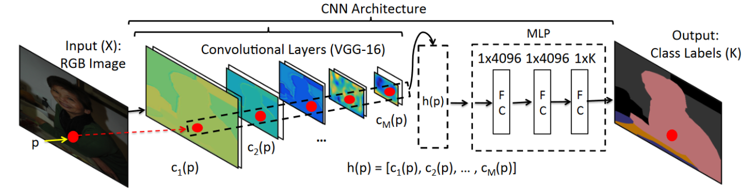
PixelNet
1
Input image fed into VGG convolutional layers
2
Hypercolumn descriptor: extracted features from each VGG layer
3
Multilayer perceptron
4
Output: class labels
As semantic segmentation is useful for autonomous driving issues, PixelNet might be a useful network
Notes:
The original architecture of PixelNet is composed of convolutional layers (VGG-16) after the input image.
These layers extract a so-called hypercolumn descriptor which then goes into a multilayer perceptron (MLP) for the nonlinear optimization. The hypercolumn descriptor consists of several features extracted from the convolutional layers.
The last layer of the MLP then generates the respective output for the given task.

Slide 4
Our approach
Implementing PixelNet with Tensorflow
Feed Cityscapes Dataset into PixelNet
Output-Bild
Training the network

Slide 5
Results

Slide 6
Results(2)

Slide 7
Outlook
Replacing the VGG-16 architecture with a ResNet implementation
Apply network to other use cases
…

Slide 8
questions?

Slide 9
Bibliography

Slide 10
Image Sources
CityScapes Dataset: Darmstadt
Robot: https://zumalo.com/wp-content/uploads/2017/05/ai-and-robotics-3252.jpg; Street Scene: https://www.volvocars.com/intl/buy/explore/intellisafe/autonomous-driving

